Slide 1
Tower defense game
By Wouter van hecke

Slide 2

Cocos creator
Cross platform
Game development

Slide 3
Demo

Slide 4


Saving/Loading the game

Slide 5

Global File

Slide 6
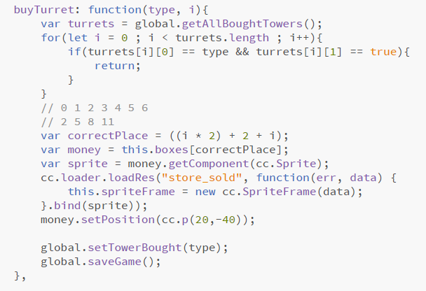
Store

Slide 7
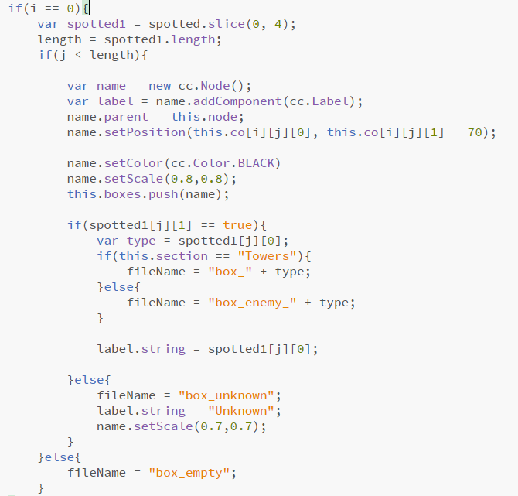
Adventure book

Slide 8
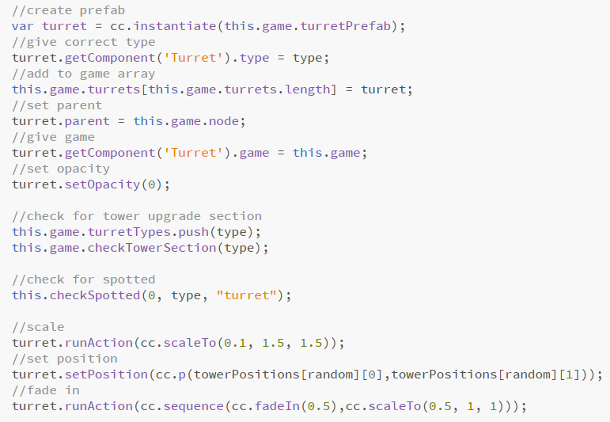
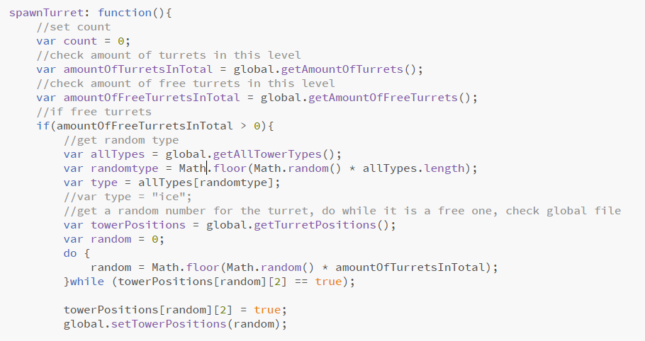
Spawner

Slide 9
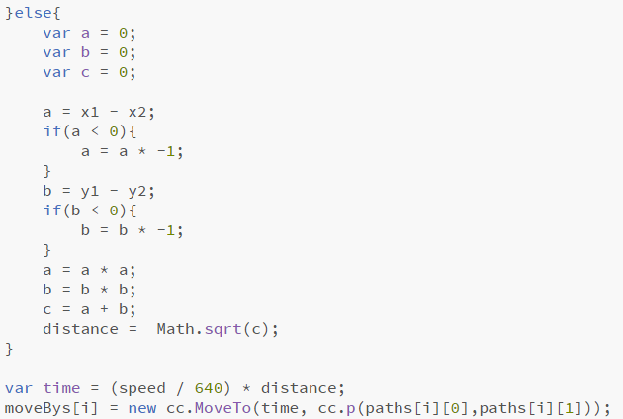
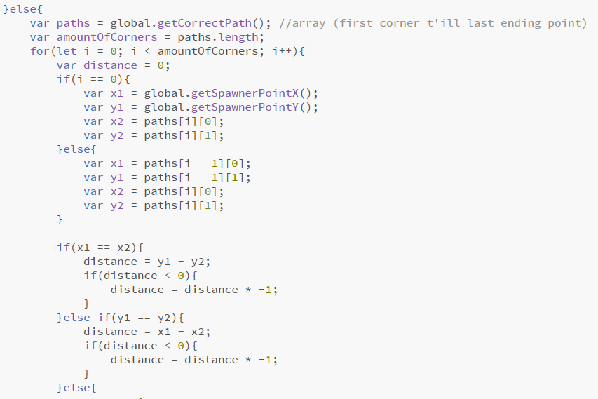
Pathfinder

Slide 10
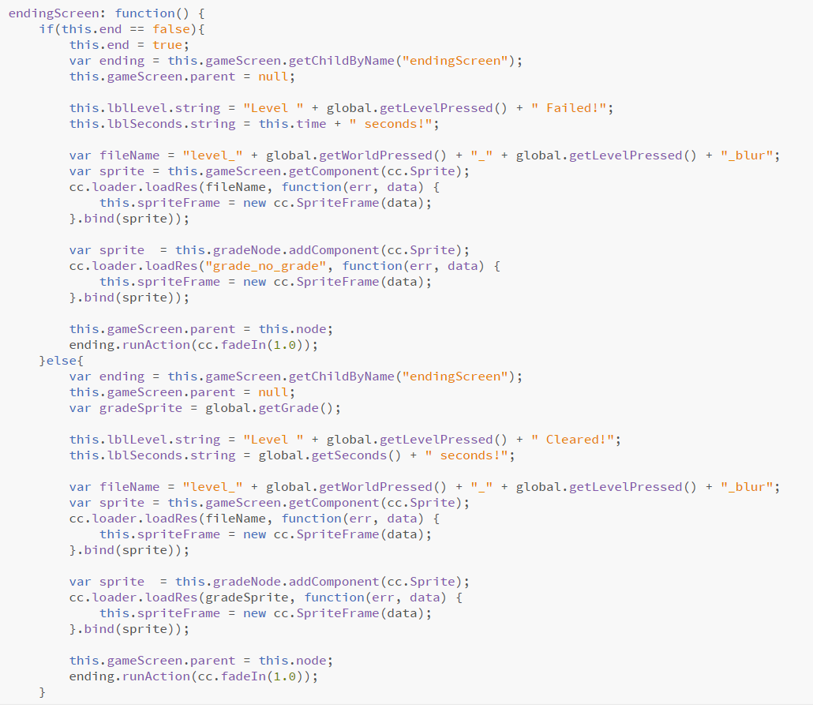

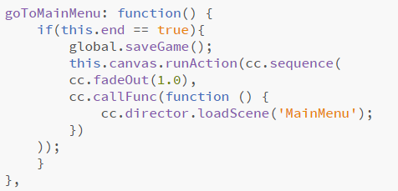
Level

Slide 11
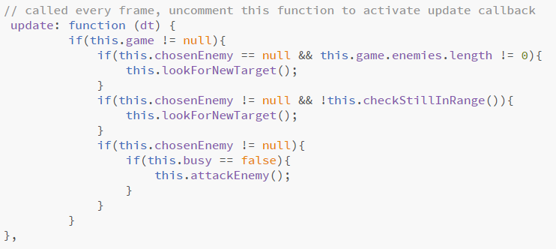
Tower

Slide 12
Thank you for your attention

